Slide 1

UNIVERSITY OF SWABI · DEPARTMENT OF COMPUTER SCIENCE
Water Angel
Smart IoT-Based Water Management & Monitoring System
Presented by Salman Khan (Roll No. 111, BS CS – Batch 12, Section C) Semester : 4th
Team Members Shayan Asim (93) · Muhammad Hamza Jamal (57) Semester : 4th
Supervisor Dr. Saeed Ahmad — Assistant Professor, Dept. of Computer Science
Semester Project(IoT) Presentation · Departmental Review

Slide 2








WHY THIS PROJECT
Traditional Water Tanks Run on Guesswork
Manual pump operation leads to waste, equipment damage, and zero visibility into water level or quality.
Overflow & Underflow
Wasted Electricity
Pump Damage
No Visibility
Delayed manual switching wastes clean water or causes shortages
Continuous or mistimed pump runtime drives up energy bills
Dry-running conditions go undetected and wear out equipment
No real-time data on current water level at all
No Remote Access
Unknown Water Quality
Lack of Automation
No Smart Control
Users can't check or control the pump while away
TDS / contamination levels are never measured
Every action depends on someone remembering to switch the pump
No intelligent decision-making exists in conventional setups
Water Angel — Project Presentation
2

Slide 3



OUR APPROACH
Water Angel: An Offline-First Smart Solution
An ESP32-based system that automates pump control using real-time water level and quality sensing — synced to the cloud and accessible from anywhere, while continuing to operate fully even when the internet goes down.
ESP32 Microcontroller
Supabase Cloud Backend
Progressive Web App
Sensor reading, pump logic, Wi-Fi & local control
Real-time sync, authentication & secure storage
Remote monitoring, control & configuration
Water Angel — Project Presentation
3

Slide 4
GOALS
Project Objectives
Automate pump control via real-time water-level sensing
Allow custom tank-height and threshold configuration
1
5
Prevent overflow and underflow conditions entirely
Support manual override alongside automatic mode
2
6
Monitor water quality continuously using a TDS sensor
Guarantee offline-first, uninterrupted operation
3
7
Enable remote monitoring & control through a mobile app
Generate real-time analytics and intelligent alerts
4
8
Water Angel — Project Presentation
4

Slide 5







HOW IT FITS TOGETHER
System Architecture
HARDWARE LAYER
SOFTWARE LAYER
Sensing — ultrasonic level + TDS quality readings
PWA — remote monitoring, control & configuration
Control — relay-driven automatic pump switching
Supabase — storage, auth & real-time sync
Local feedback — LCD, LED indicators & buzzer
Analytics — usage trends & intelligent alerts
Persistence — config stored safely in EEPROM
Offline engine — full local function w/o internet
Water Angel — Project Presentation
5

Slide 6








INSIDE THE BUILD
Core Hardware Components
ESP32 Microcontroller
Ultrasonic Sensor
TDS Sensor
Brain of the system — sensing, control & connectivity
Measures distance to water surface for level %
Detects dissolved solids to flag poor water quality
Relay Module
Water Pump
16×2 I2C LCD
Electronic switch driving the water pump safely
Fills the tank — runs in auto or manual mode
Local display for level, TDS, pump status & mode
LEDs & Buzzer
EEPROM Storage
Setup Button
Visual / audible alerts for critical conditions
Retains Wi-Fi, thresholds & calibration on reboot
Hold 3s to open Wi-Fi provisioning hotspot
Water Angel — Project Presentation
6

Slide 7
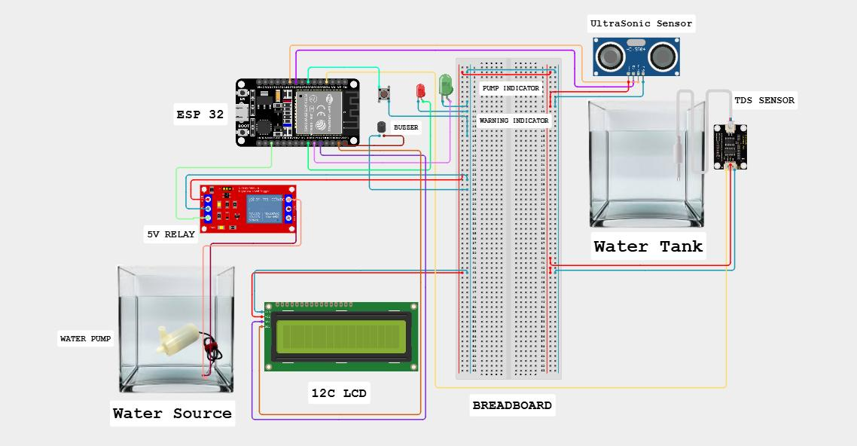
WIRING IT UP
Circuit Design
ESP32 connected to the ultrasonic level sensor, TDS sensor, relay module, LCD, LEDs and buzzer on a breadboard prototype
Water Angel — Project Presentation
7

Slide 8
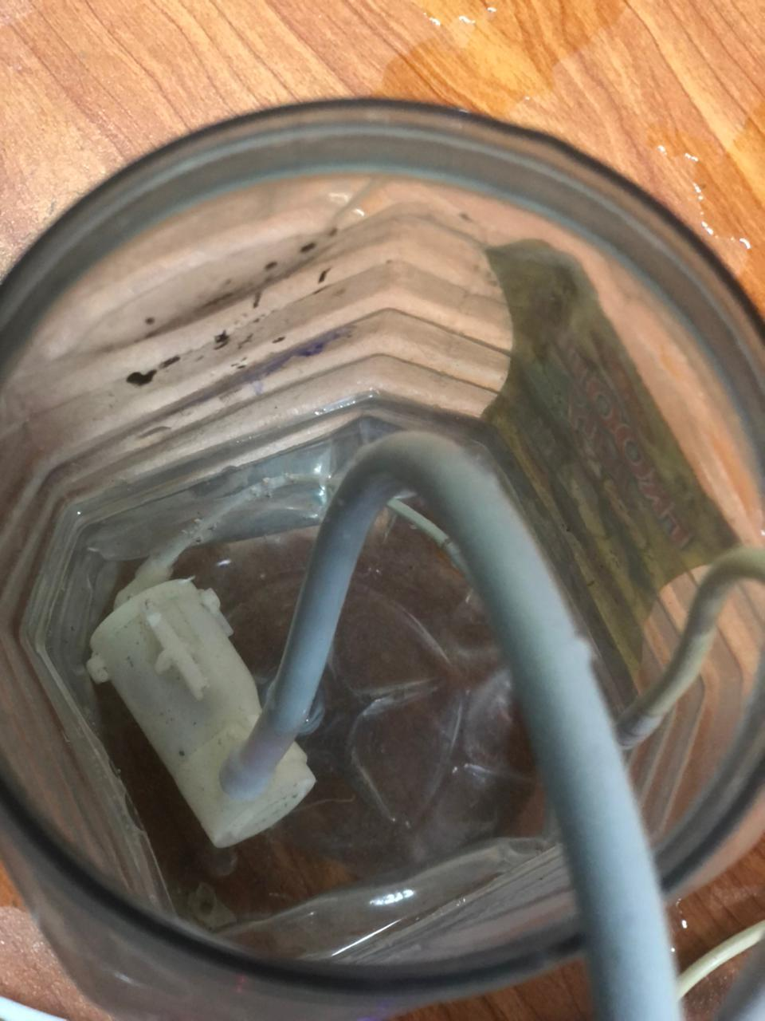
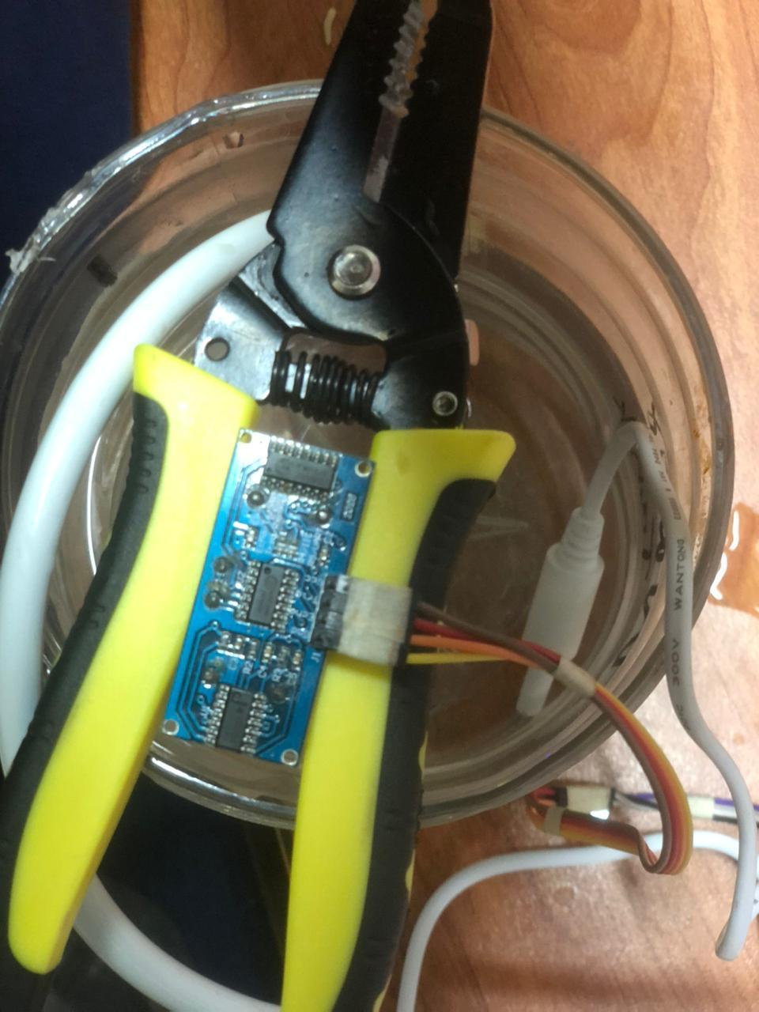
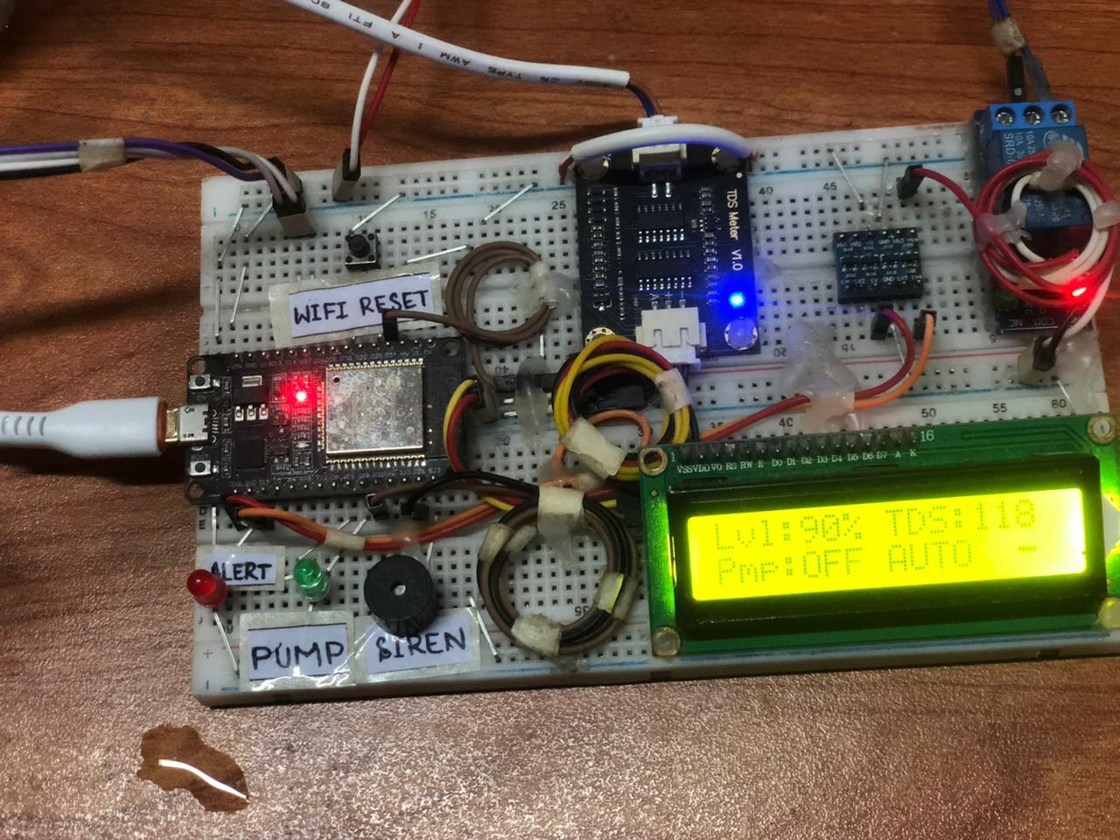
BUILT & TESTED
From Diagram to Working Prototype
Water Source
Water Tank
Main Circuit Board
Water Angel — Project Presentation
8

Slide 9



BEHIND THE APP
Software Architecture
Water Angel PWA
Supabase Backend
Offline-First Engine
The primary interface — monitor levels, control the pump, configure thresholds, view analytics, and receive alerts from any browser.
Cloud database, authentication and real-time sync. Sensor readings, pump status, and configuration all live here.
Critical functions — level sensing, TDS monitoring, automatic pump control — keep running with zero internet.
When connectivity returns, the ESP32 automatically resumes syncing readings, status, and settings with the cloud.
Water Angel — Project Presentation
9

Slide 10




FIRMWARE ENGINEERING
Dual-Core FreeRTOS Architecture
HTTP calls to Supabase were blocking the sensor loop — causing overflow. Splitting across two cores eliminated the problem entirely.
CORE 1 — SENSOR & CONTROL
CORE 0 — CLOUD & NETWORK
Ultrasonic water-level reading
Supabase GET / POST (blocks up to 10 s)
TDS water quality sampling
SensorSnapshot
fetchDeviceInfo & fetchPumpSettings
level · tds · pumpOn
pumpMode · runtimeMin
Pump ON / OFF control logic
FreeRTOS
Queues
sendSensorData every 30 s
LCD, LED & buzzer feedback
WiFi connection & auto-retry
CloudSettings
Setup button & beep handler
thresholds · tankHeight
pumpMode · manualCmd
Re-syncs settings on reconnect
Priority 2 · Cycle every 50 ms · Pump reacts in < 550 ms
Priority 1 · Yield every 100 ms · Never touches sensor pins
Result: HTTP calls can now block Core 0 for up to 10 seconds — pump control on Core 1 is completely unaffected. Overflow eliminated.
Water Angel — Project Presentation
10

Slide 11
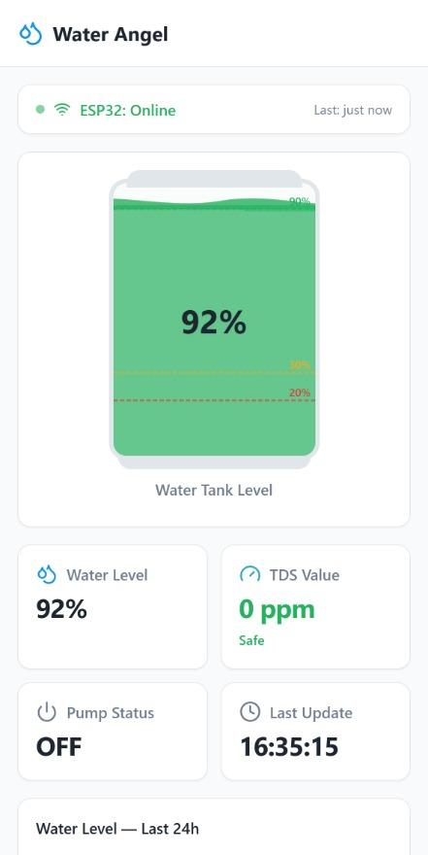




WATER ANGEL PWA · TAB 1
Home Dashboard
A single real-time overview of the entire water management system.
Live ESP32 connectivity status
Always know if the device is online and when it last reported in
Visual tank-level gauge
Animated fill graphic shows the exact water percentage at a glance
Water quality at a glance
TDS reading with a clear Safe / Unsafe indicator
Pump status & last update
Current ON/OFF state plus the most recent sync timestamp
24h history & smart insights
Usage trend graph with auto-generated tips like refill timing
Water Angel — Project Presentation
11

Slide 12
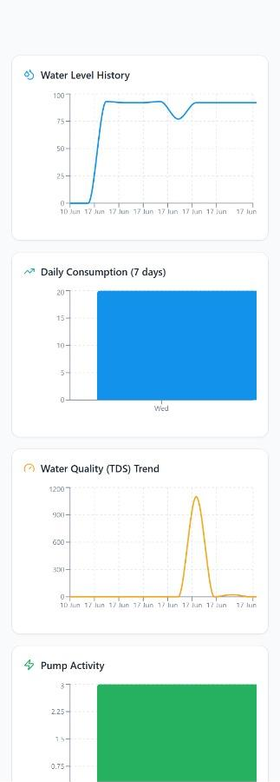



WATER ANGEL PWA · TAB 2
Analytics Dashboard
Turns raw sensor readings into usage trends, scores, and recommendations.
7-day water level history
Trend line shows refill events and gradual consumption
Consumption & TDS trend analysis
Daily usage bars and a 7-day water-quality trend line
Pump activity tracking
Logs how often and how long the pump has been running
Water Efficiency Score
A single number summarizing how well the tank is managed
Weekly smart report
Auto-generated recommendations, e.g. peak usage windows
Water Angel — Project Presentation
12

Slide 13
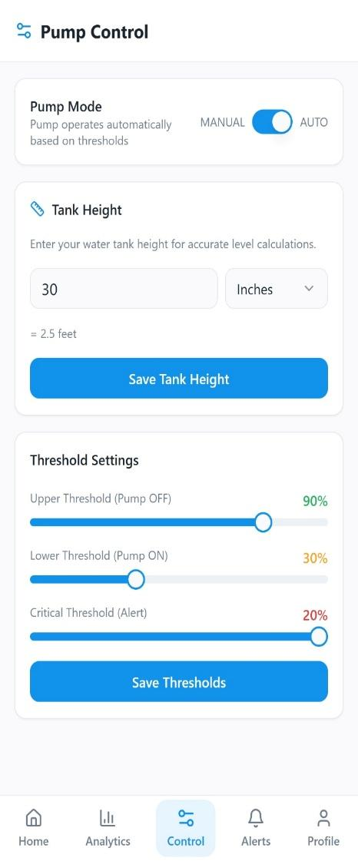
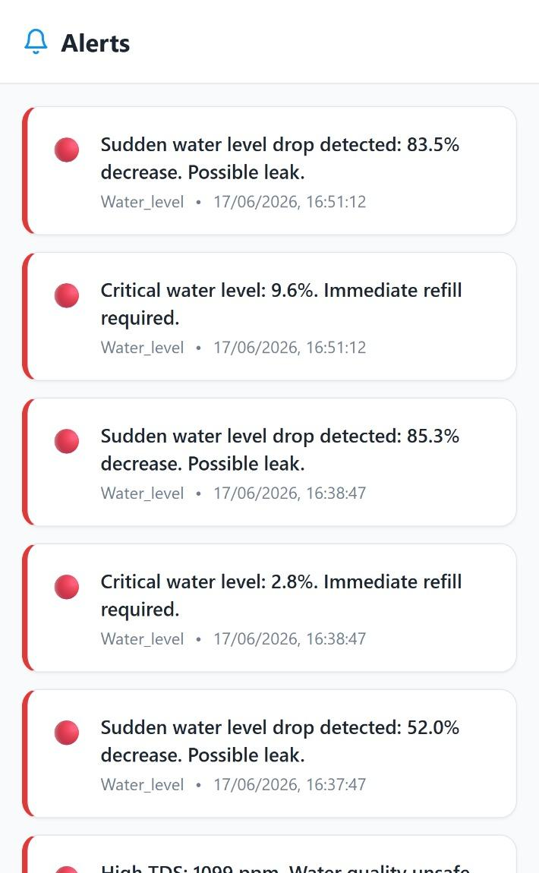


WATER ANGEL PWA · TABS 3 & 4
Control & Alerts
PUMP CONTROL
ALERTS
Switch between Automatic and Manual pump modes
Sudden-drop / leak detection
Set custom tank height for accurate level %
High-TDS water quality warnings
Adjust Upper / Lower / Critical thresholds live
Critical low-level refill alerts
Every alert is timestamped & categorized
Water Angel — Project Presentation
13

Slide 14
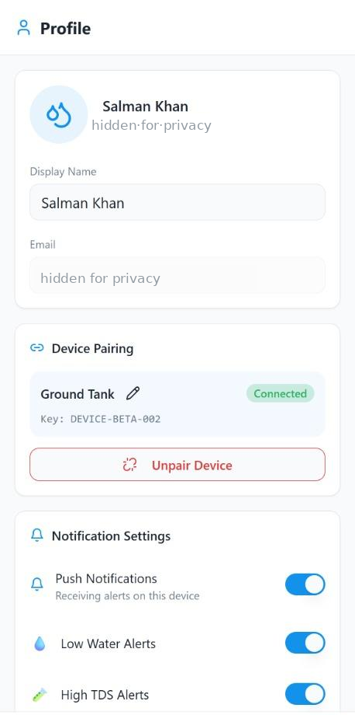

WATER ANGEL PWA · TAB 5
Profile & Account
Account management, device pairing, and system configuration in one place.
Device pairing
Connect the app to a specific Water Angel unit via its unique Device Key
Notification preferences
Independently toggle Low Water, High TDS, Pump Status & Anomaly alerts
Wi-Fi & calibration
Update Wi-Fi credentials and recalibrate tank height anytime
Account security
Change password and sign out safely from the connected device
Water Angel — Project Presentation
14

Slide 15
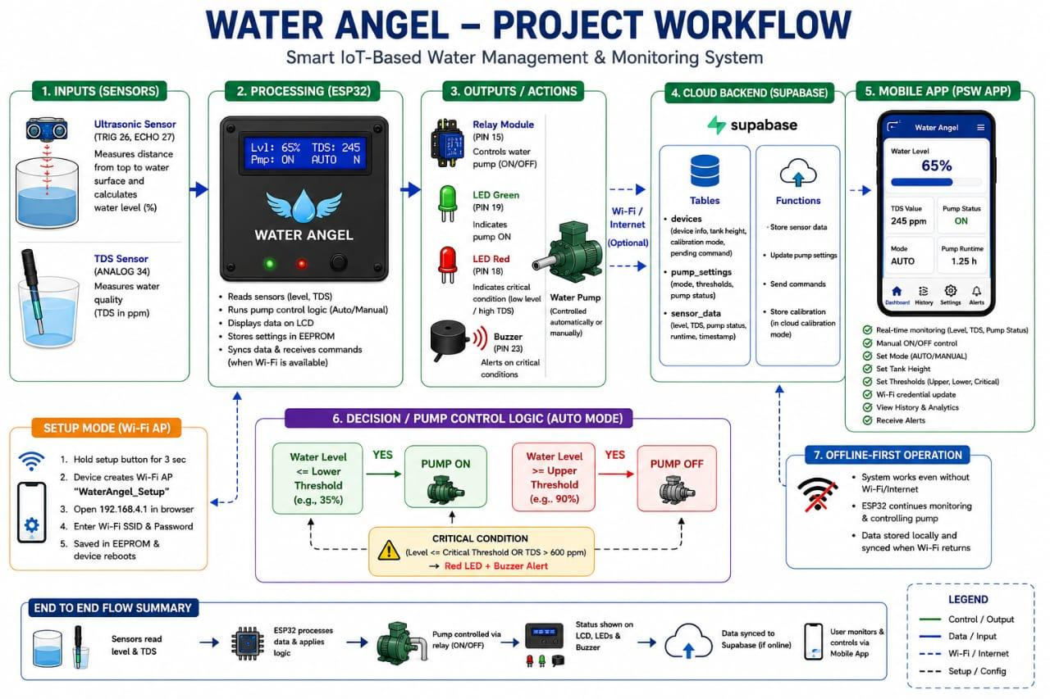
END TO END
Water Angel — Project Presentation
15

Slide 16

PROVEN, NOT JUST PLANNED
Results & Achievements
Every core feature was implemented, tested, and verified working end-to-end.
Automatic pump control working reliably
Water quality (TDS) monitoring implemented
Offline-first operation verified under no internet
Alert & notification system live
Cloud synchronization tested successfully
Intelligent analytics dashboard developed
Real-time monitoring fully implemented
Wi-Fi provisioning & remote configuration working
Water Angel — Project Presentation
16

Slide 17





REAL-WORLD IMPACT
Benefits & Deployment Areas
KEY BENEFITS
DEPLOYMENT AREAS
Reduces water wastage from overflow
Residential homes & domestic tanks
Saves electricity via optimized pump runtime
Apartment buildings & housing societies
Prevents pump damage from dry-running
Educational institutions & hostels
Real-time visibility into level & quality
Commercial buildings & small industries
Remote accessibility from anywhere
Agricultural farms & irrigation systems
Water Angel — Project Presentation
17

Slide 18






WHAT'S NEXT
Future Enhancements
Water Angel v1.0 is complete — here's where it can grow next.
AI-Based Prediction
Leakage Detection
Solar-Powered Operation
Mobile Push Notifications
Advanced Water Quality
Smart Community Management
Forecast consumption patterns and pre-emptively schedule refills
Identify abnormal flow or sudden drops and alert before water is lost
Remove dependency on grid power for full energy independence
Native push alerts instead of in-app notifications only
Add sensors for pH, turbidity & chlorine beyond TDS alone
Scale a single dashboard across multiple connected tanks
Water Angel — Project Presentation
18

Slide 19

Water Angel modernizes traditional water management — reducing waste, saving energy, and enabling smart, remote, real-time control.
Thank You
Questions & Answers
Salman Khan
BS Computer Science · University of Swabi
Scan for Water Angel App

